Slide 1
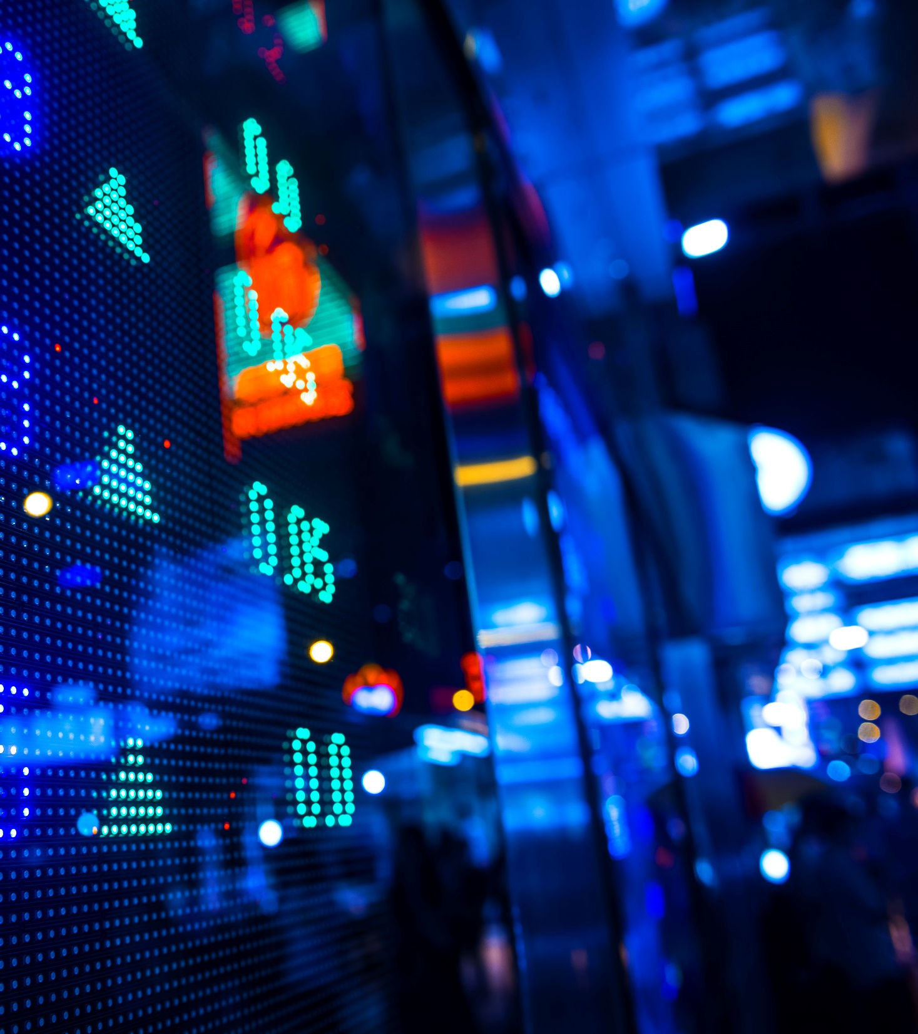
Bitcoin prediction
Next Hour Bitcoin Prediction
Lamiss Gargouri

Slide 2
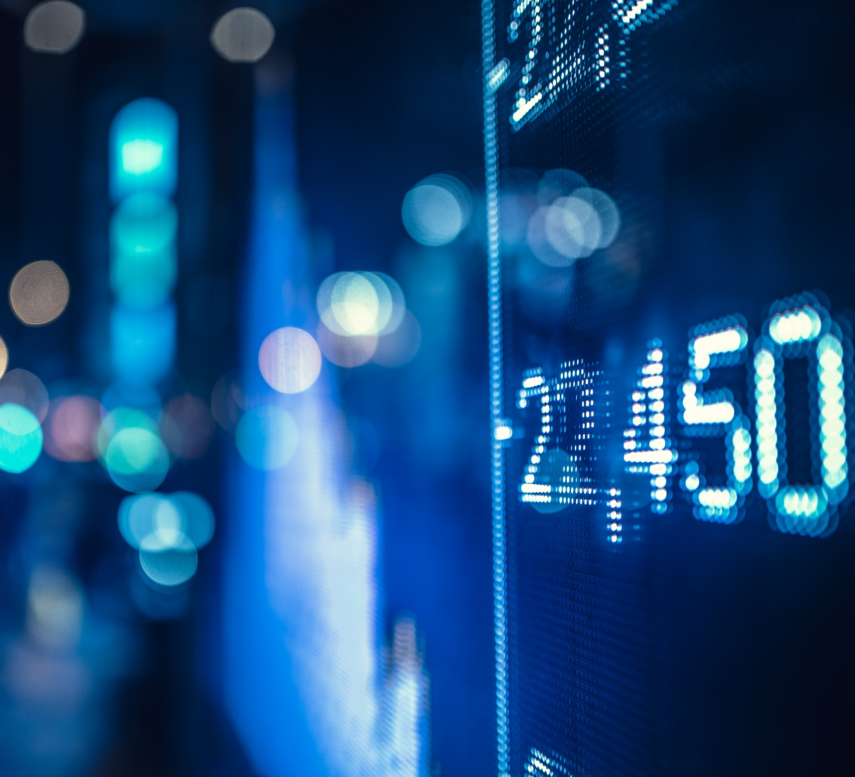
Table of content
Introdcution
Dataset
Data Visualization
Prediction Using Neural Netwok

Slide 3

Introduction
When it comes to trading, there are several strategies that can be used to determine the best moment to invest. Some may examine the financials to determine if there is worth hidden under the surface. Others could pay attention to the daily news to see how it affects the present pricing. Another group could study historical price fluctuations to see if there are any patterns that can be used to predict future price movements.

Slide 4
Introduction
What is Bitcoin?
First decentralized digital currency
Transformed Directly
Known as peer to peer
Wallet lost ➔ bitcoins lost

Slide 5
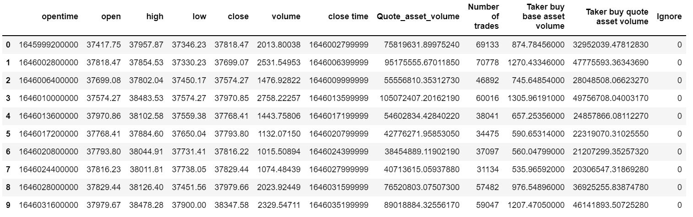
Dataset
Send a request to binance server for bitcoin USD every 1 hour since 100 days ago. The data will be stored in the variable Klines.
The API has 3 parameters :
BTCUSDT
Candle Time
Time Frame

Slide 6
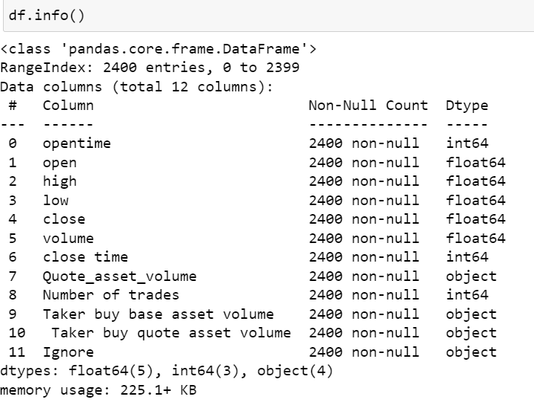
Understanding Data
Pandas describe() is used to view some basic statistical details like percentile, mean , std , etc… .
Pandas shape() returns the shape of an array.
Pandas info() help us to get a concise
Summary of the dataframe.

Slide 7
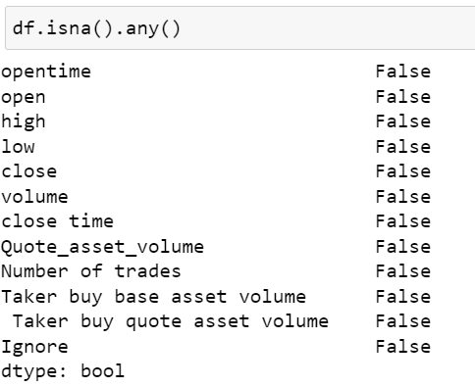
Understanding Data
Pandas unsa() any() detect missing values for and array
Pandas isnull() sum() returns the number of missing values in the dataset.

Slide 8
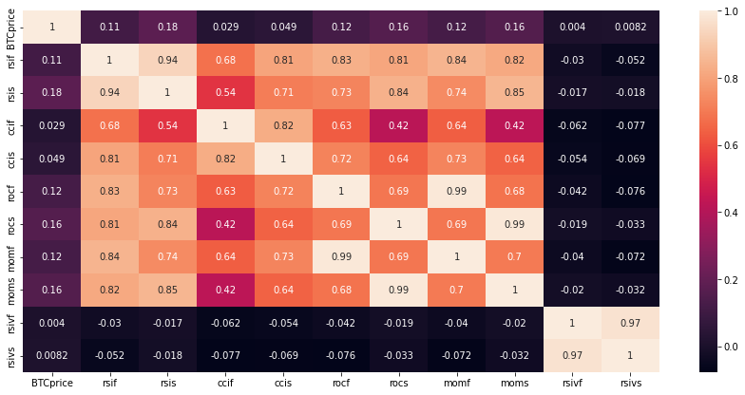
Data Visualization
➔ To predict the bitcoin price , the best indicators are : rsi, roc, mom.

Slide 9
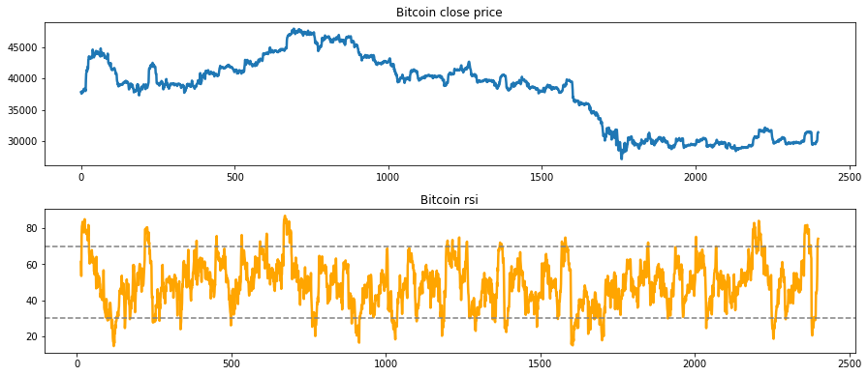
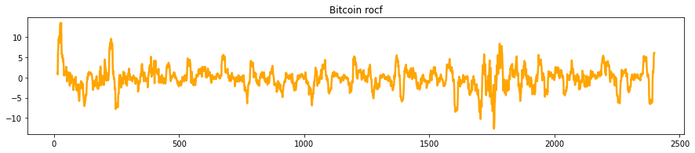
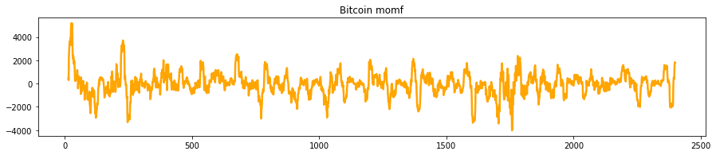
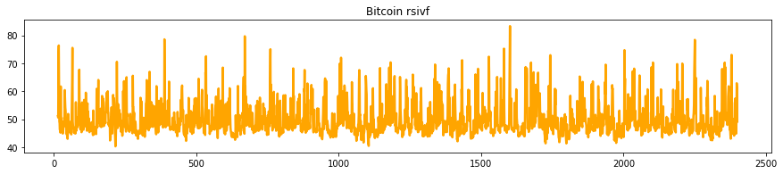
Data visualization

Slide 10
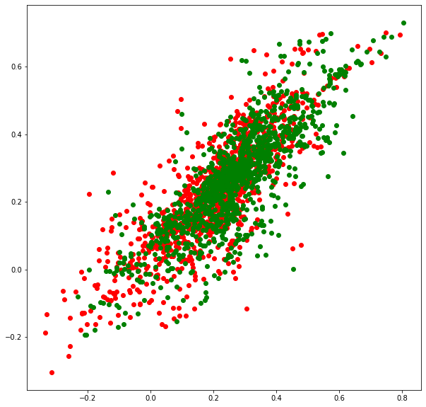
Data visualization

Slide 11
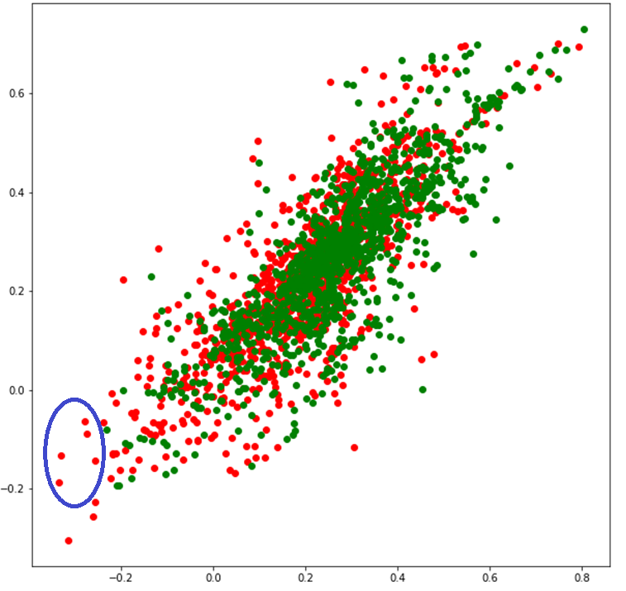
Data visualization

Slide 12
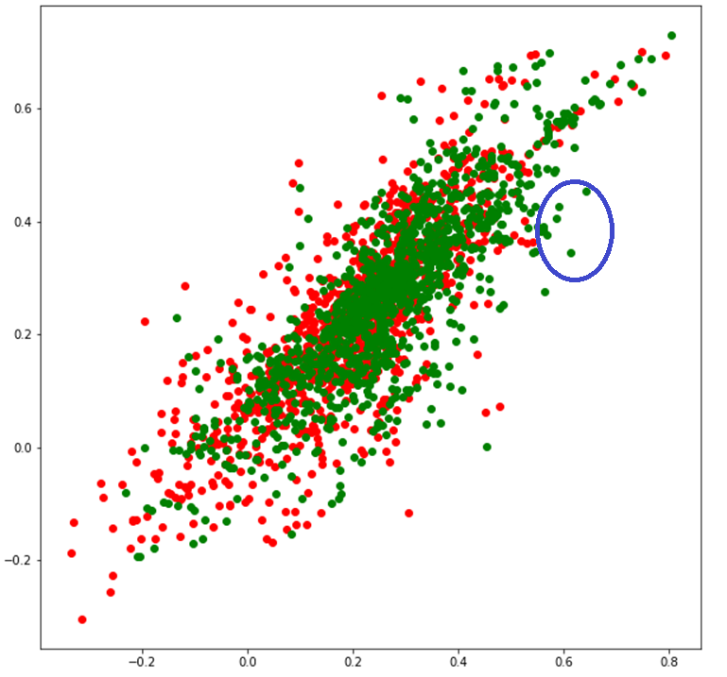
Data visualization

Slide 13
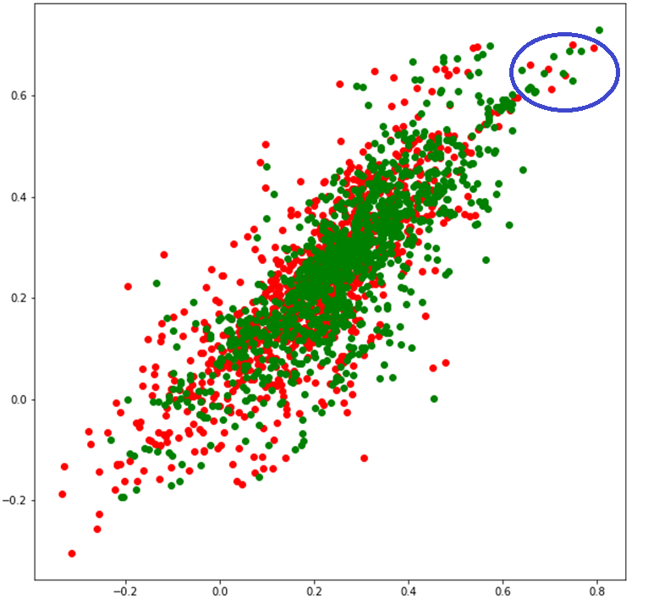
Data visualization

Slide 14
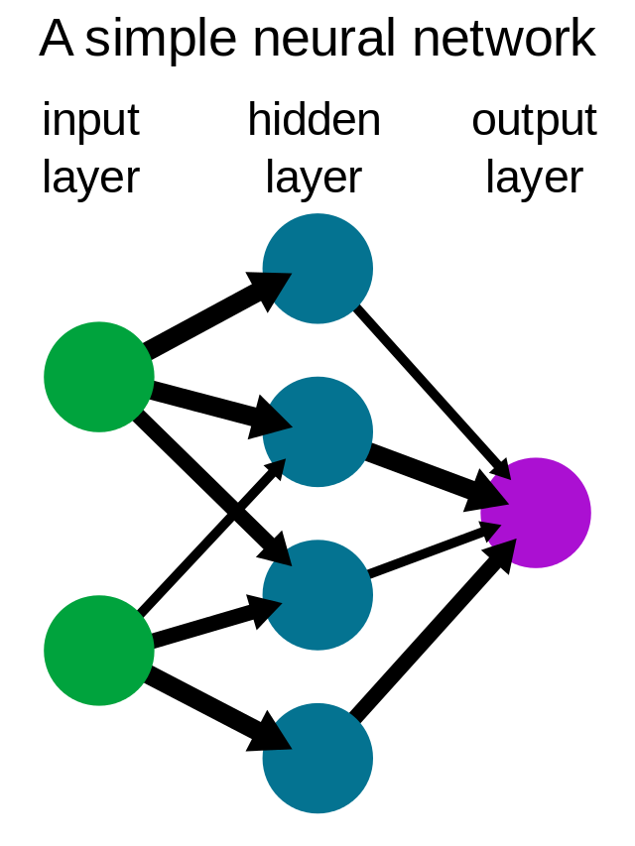
Neural Network
In the domains of AI, machine learning, and deep learning, neural networks imitate the activity of the human brain, enabling computer programs to spot patterns and handle basic problems.

Slide 15
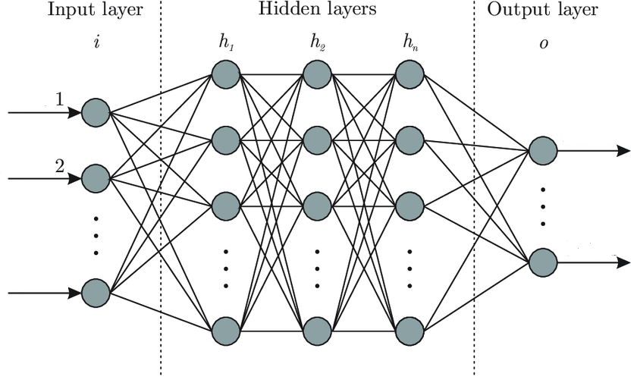
Neural Network
Feature
Class 1
Feature
Class 2
Feature10
512
512
256

Slide 16
Neural Network

Slide 17
Conclusion
When there isn't enough fundamental data to go on, we may rely on Technical Indicators to help us trade Bitcoin. We may incorporate new features (technical indicators) to the dataset instead of the typical price and volume history if we wanted to add more variables to a trading algorithm or a machine learning forecasting model. When using a machine learning model to estimate future prices, this strategy may be useful.

Slide 18
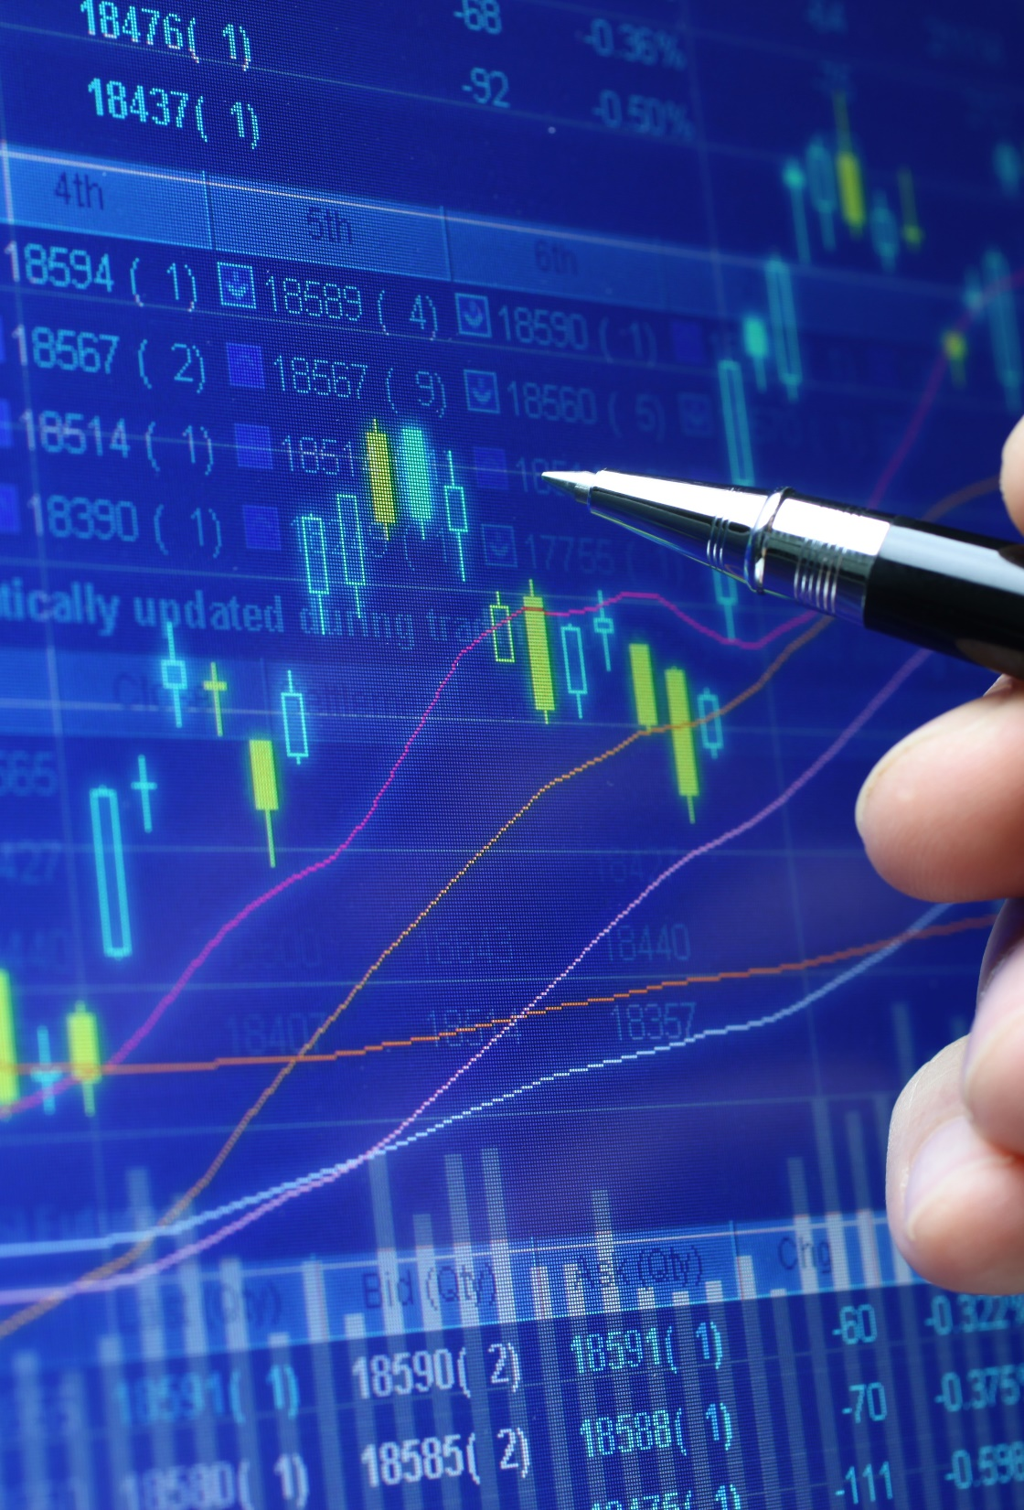
Thank you

